Slide 1

First round elaboration
Matteo Ferla
15/6/23
ASAP Comp Chem Science Meeting
✉️ matteo.feral@stats.ox.ac.uk
🦤 @matteoferla
🐙 matteoferla
🌐 www.matteoferla.com
✏️ blog.matteoferla.com

Slide 2
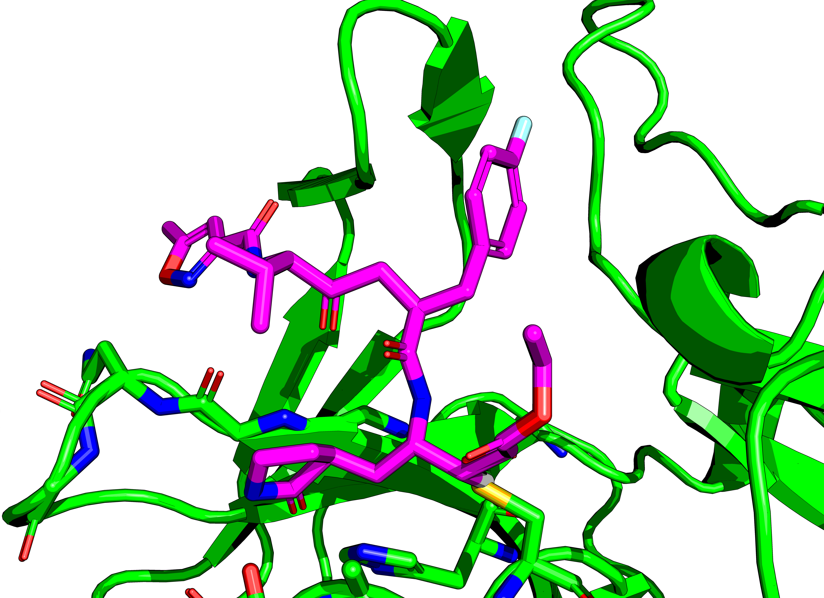
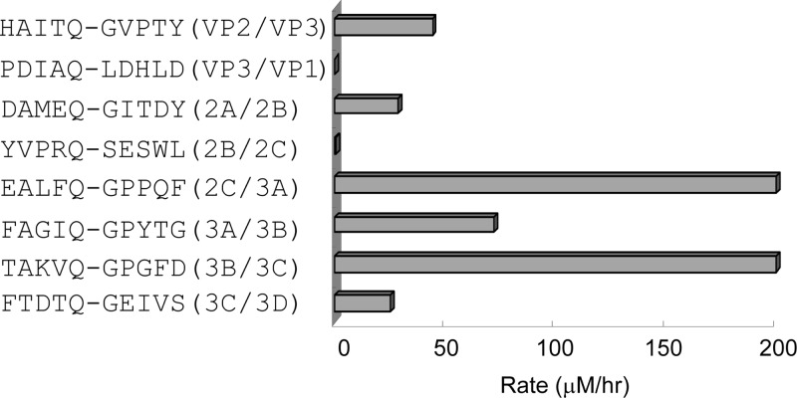
EV D68 3C protease
Consensus from Tan et al. J. Vir. 2013
XXXΦQ↓GPXXX
PBD:2B0F peptiodomimetic X[ACE]LEALFX[YTF]
where YTF is Gln-like+ethylpropionate

Slide 3
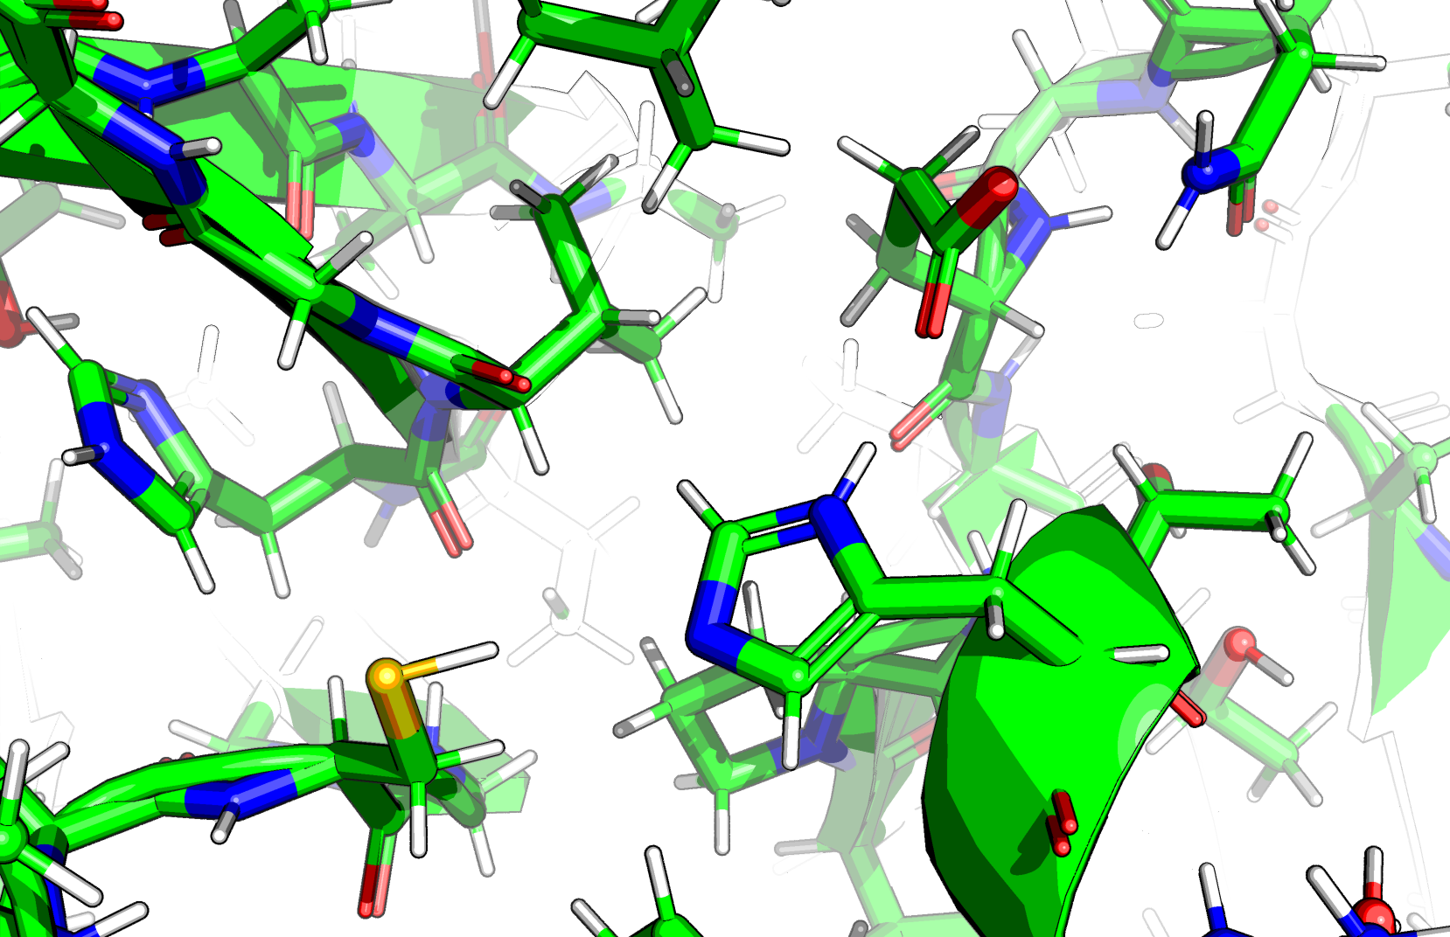
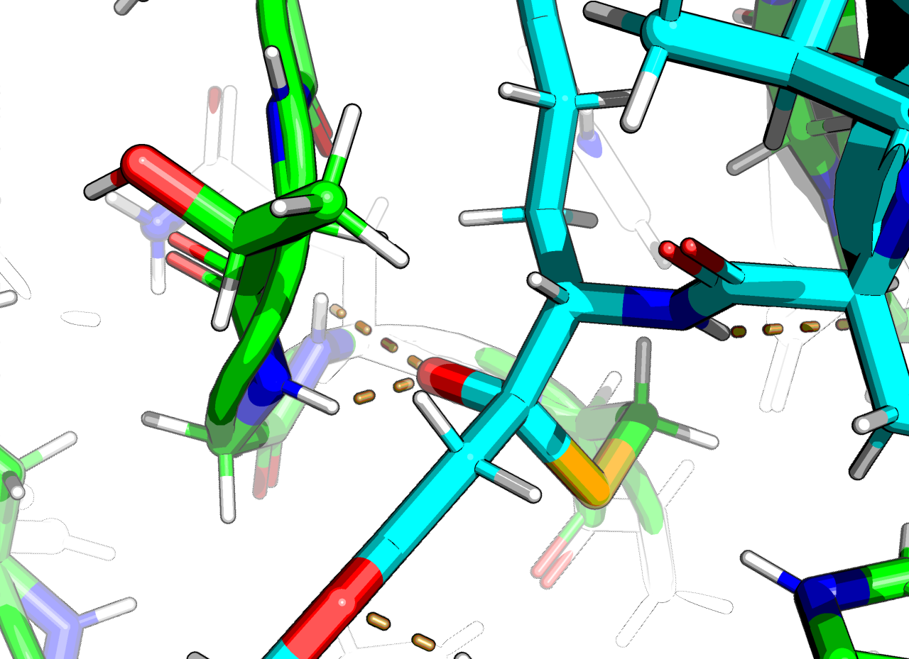
Catalysis
Cys + His + Glu triad
Ignore protonation: CYS···HID···GLU vs. CYZ···HIE···GLH
Oxanion pocket w/ -OH in 2B0F
(HOH in others) backbone amide nitrogens of G145 and Q146

Slide 4
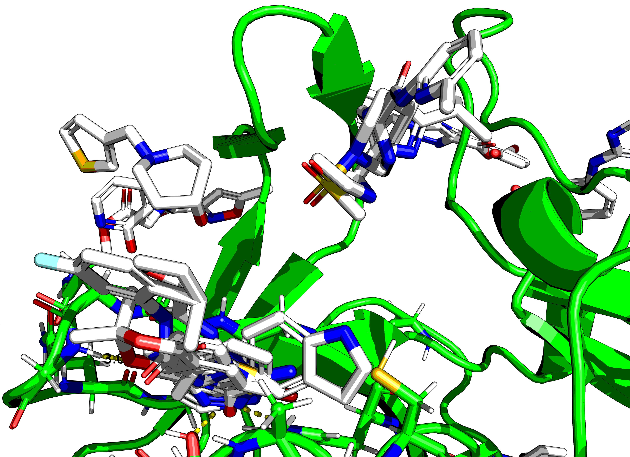
Hits
Native-substrate (like)
Hits

Slide 5
Analysis
https://github.com/matteoferla/EV-D68-3C-protease
Fragment extraction
Fragment theft from PDB via Blastp
Fragment merging w/ Fragmenstein
Fragment link w/ Steph’s fragment network
Decomposition and manual analogue search
Fragment elaboration

Slide 6
Fragment extraction
Alphanumerically first bound structure chosen as template
Blind
ideally transition state bound…
But proteases don’t have a major catalytic movement normally
My code: PyMOL alignment to template per chain, split by segment id, chain, residue index and ins-code, followed by filtering by proximity to template peptide chain.
No Filtering by near identical conformers: > combinatorial cost
Connor in XChem is working on Xchem align which may be better, but I want to assume asymmetric dimers are symmetric!

Slide 7
Fragment theft
Sequence --> Blastp against PDB
Not psi blast. No homologues in the Felsenstein zone (<20% id)
I have a kill list of crystallographic ligand cf. https://blog.matteoferla.com/2019/11/go-away-glycerol.html but did not use it

Slide 8
Fragmenstein
https://github.com/matteoferla/Fragmenstein
Multiple steps:
Fragment merging by atomic position
analogue search via Brian Schoichet’s Small World
constrained “placement”
PLIP annotation
Basic linking (hydrocarbon). P1 and P2 are 7Å away: unfeasible
No followups with high number of interactions or ∆∆G-like
Worse with BRICS decomposed

Slide 9
Fragment network
https://github.com/stephwills/fragment_network_merges
Fast enumeration of library compounds w/ substratures matching a hit + BRICS synthon of a 2nd hit thanks to Fragalysis’s Fragment network (Neo4J DB linking 0.5B compounds by expansions that cannot be “jumped into” by similarity)
“Placed” with Fragmenstein
Does not explore analogues of the starting hits
Nothing bridged the P1 & P2 sites.
Future: analogues

Slide 10
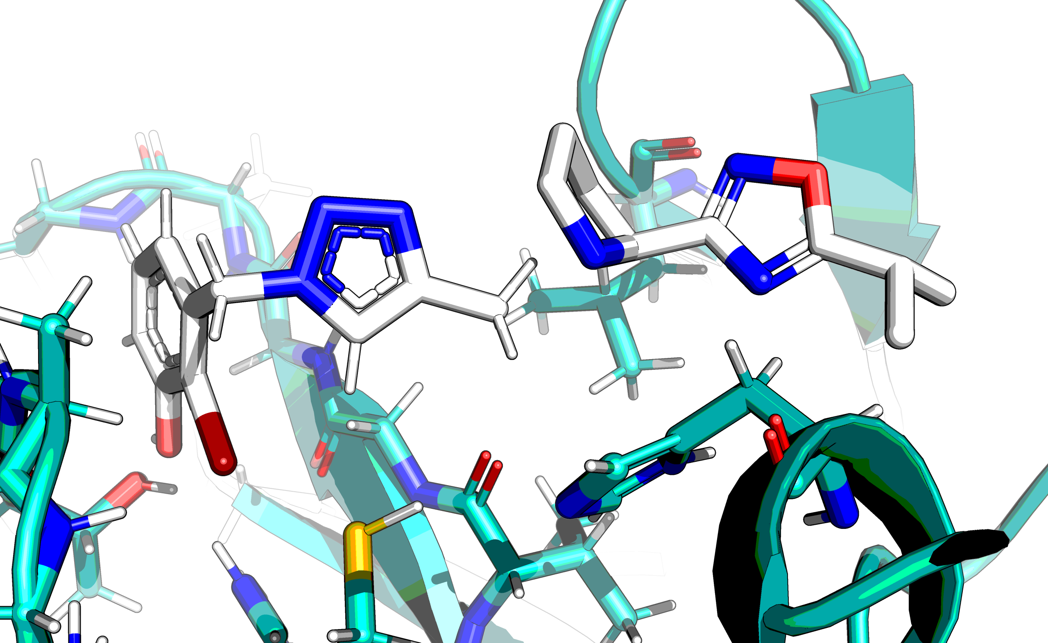
In Extremis
Worse case scenario for gap bridging
ZINC1536013595 has an azide
Huisgen cycloaddition is one pot, water (& DMSO-ish), RT, and copper does not need removal
Add together and use: no need for CAR from P3 money pot
Bonus: triazole might form a pi-S

Slide 11
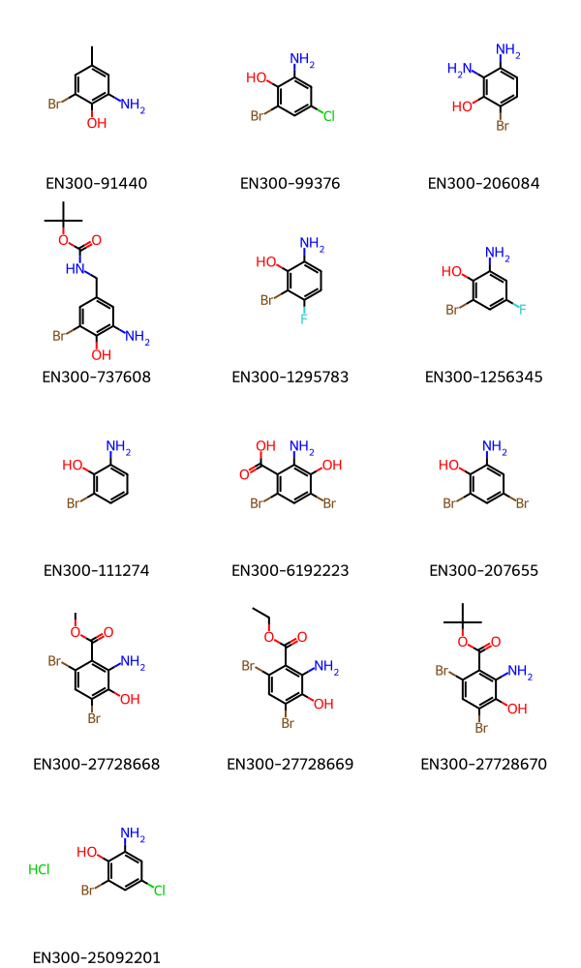
Example of “inelaborability”: bromophenols w/ amine
Hits are not the most elaboratable
Bromophenol with amine next to Bromine say? (For T3P amidation or Schotten–Baumann amidation)
No luck… Only a handful of Enamine BB…

Slide 12
Something somewhere
There are close analogues that can link P1 and P2
I just have not explored them
To do:
close analogue of hits from Enamine BB enumerated & linked
Linkers from Erlt et al. Bioorg Med Chem 2023 placed in between and analogye search
Other… Generative models (→ Kate)

Slide 13
Manual exploration

Slide 14
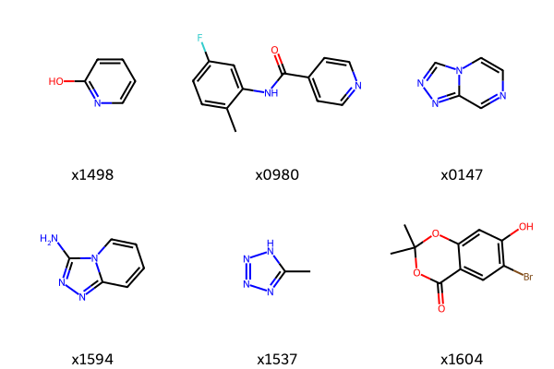
Sites
0 hits fill the oxyanion pocket
3 hits interact with thiol
6 hits fill Gln pocket
1 amide…
3 Acceptor-acceptor diazo rings
0 hits
P2 pocket poor hits

Slide 15
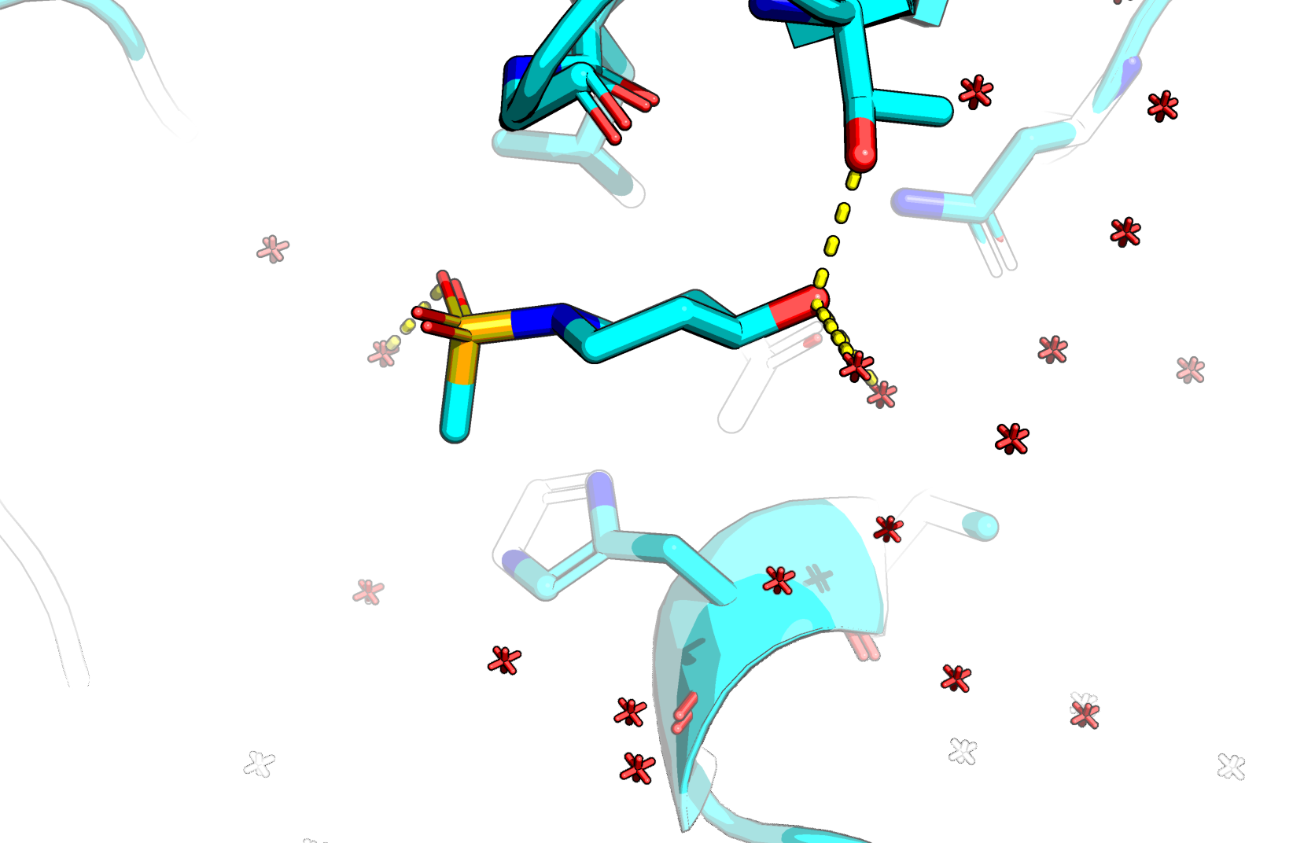
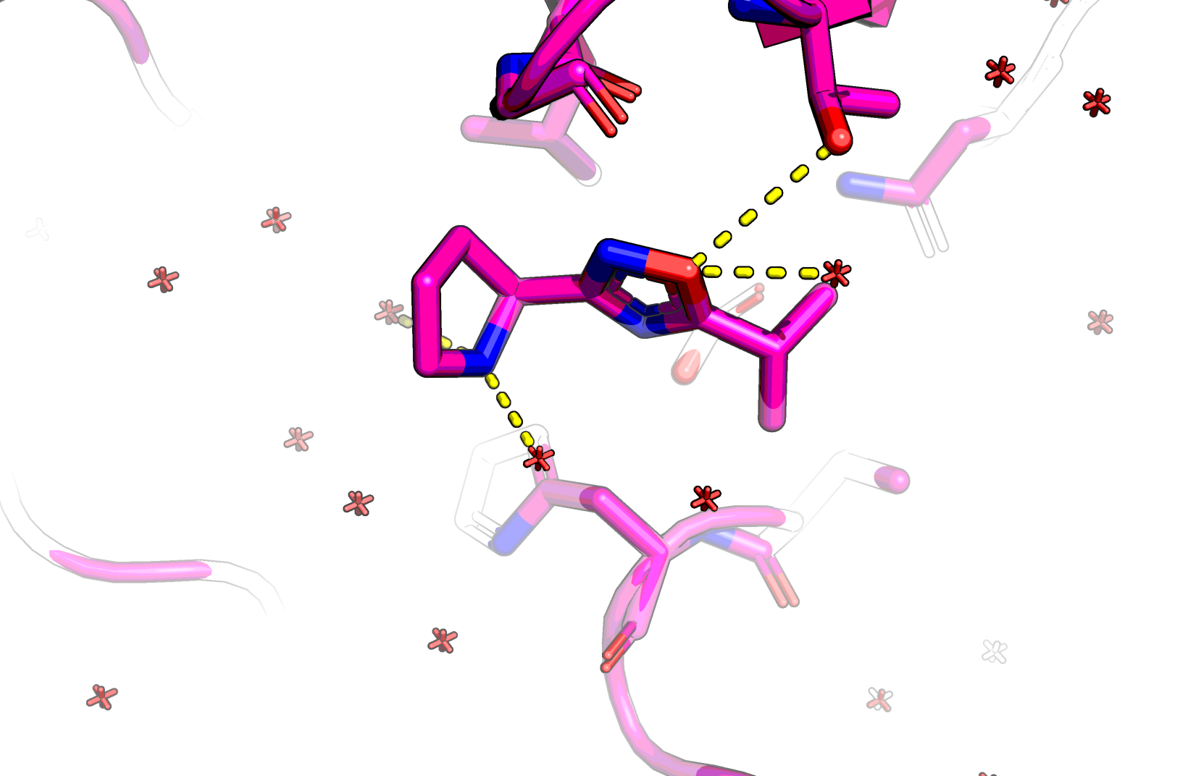
P2 hits
X1083 (water bridged)
X1305 (sole aromatic ring)

Slide 16
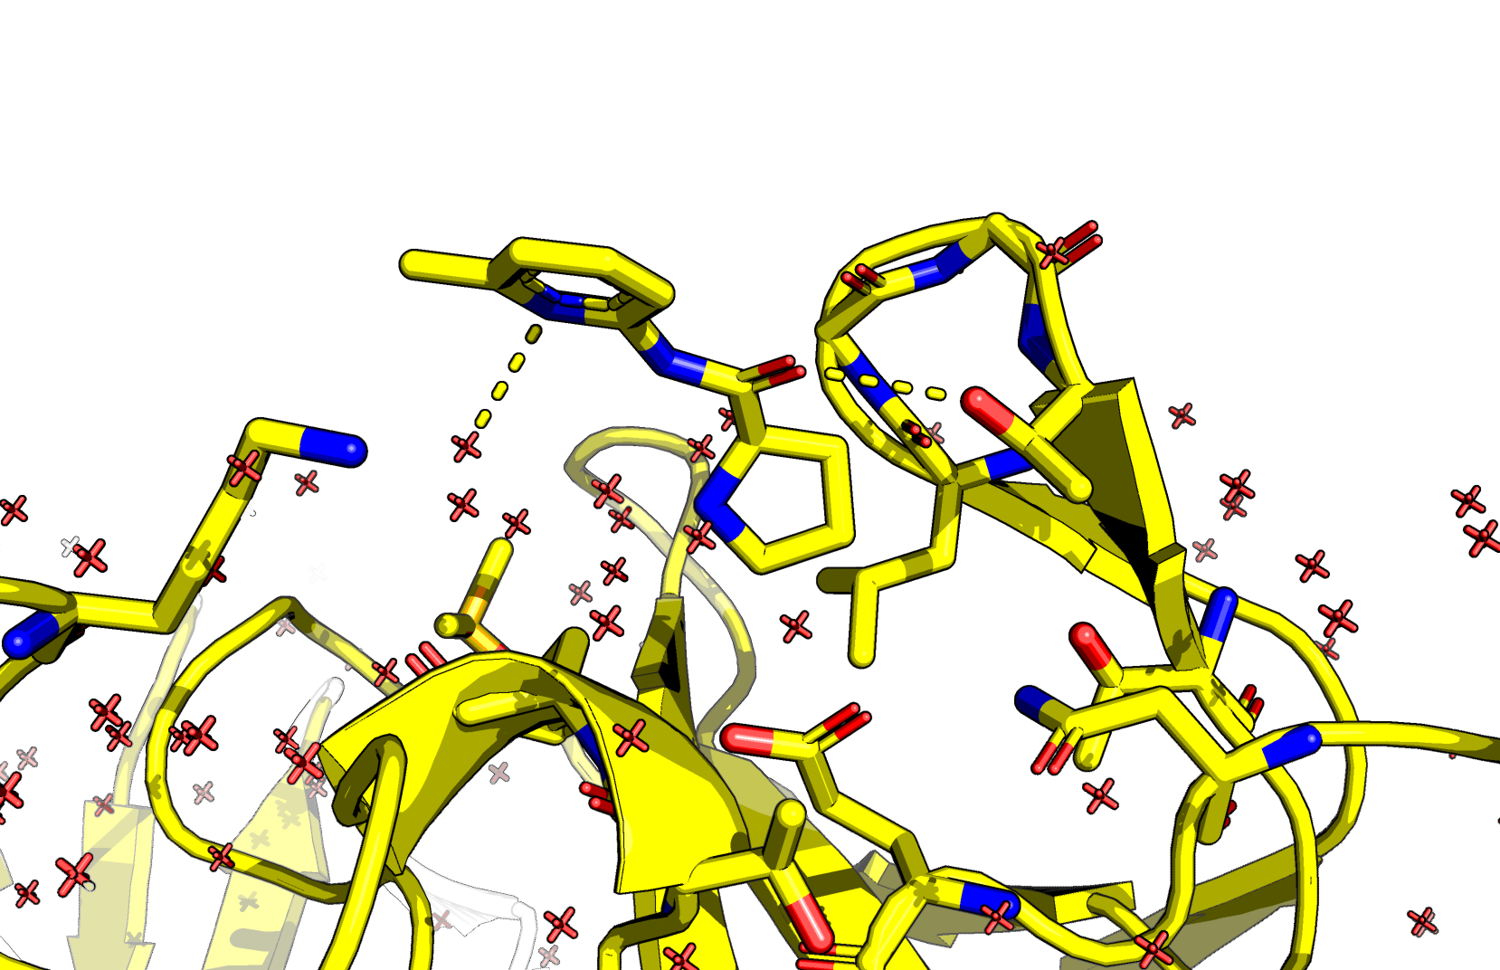
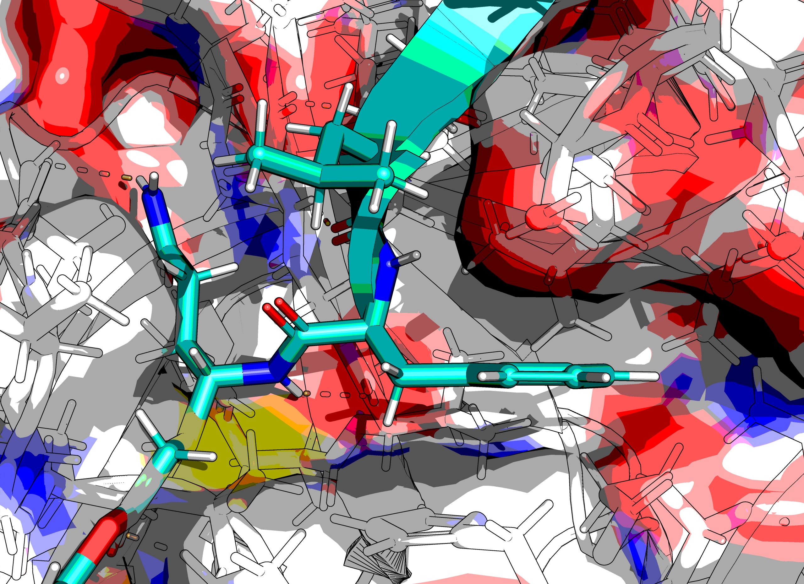
P2 hits continued
x1247
Nothing interacting with catalytic histidine by pi-pi

Slide 17
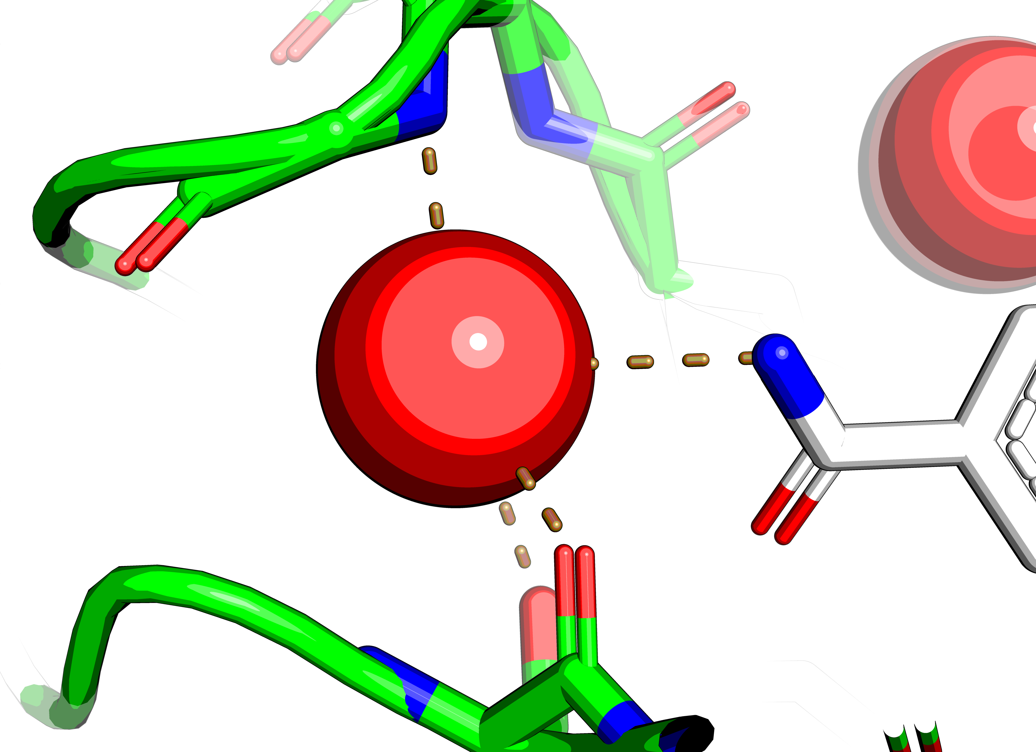
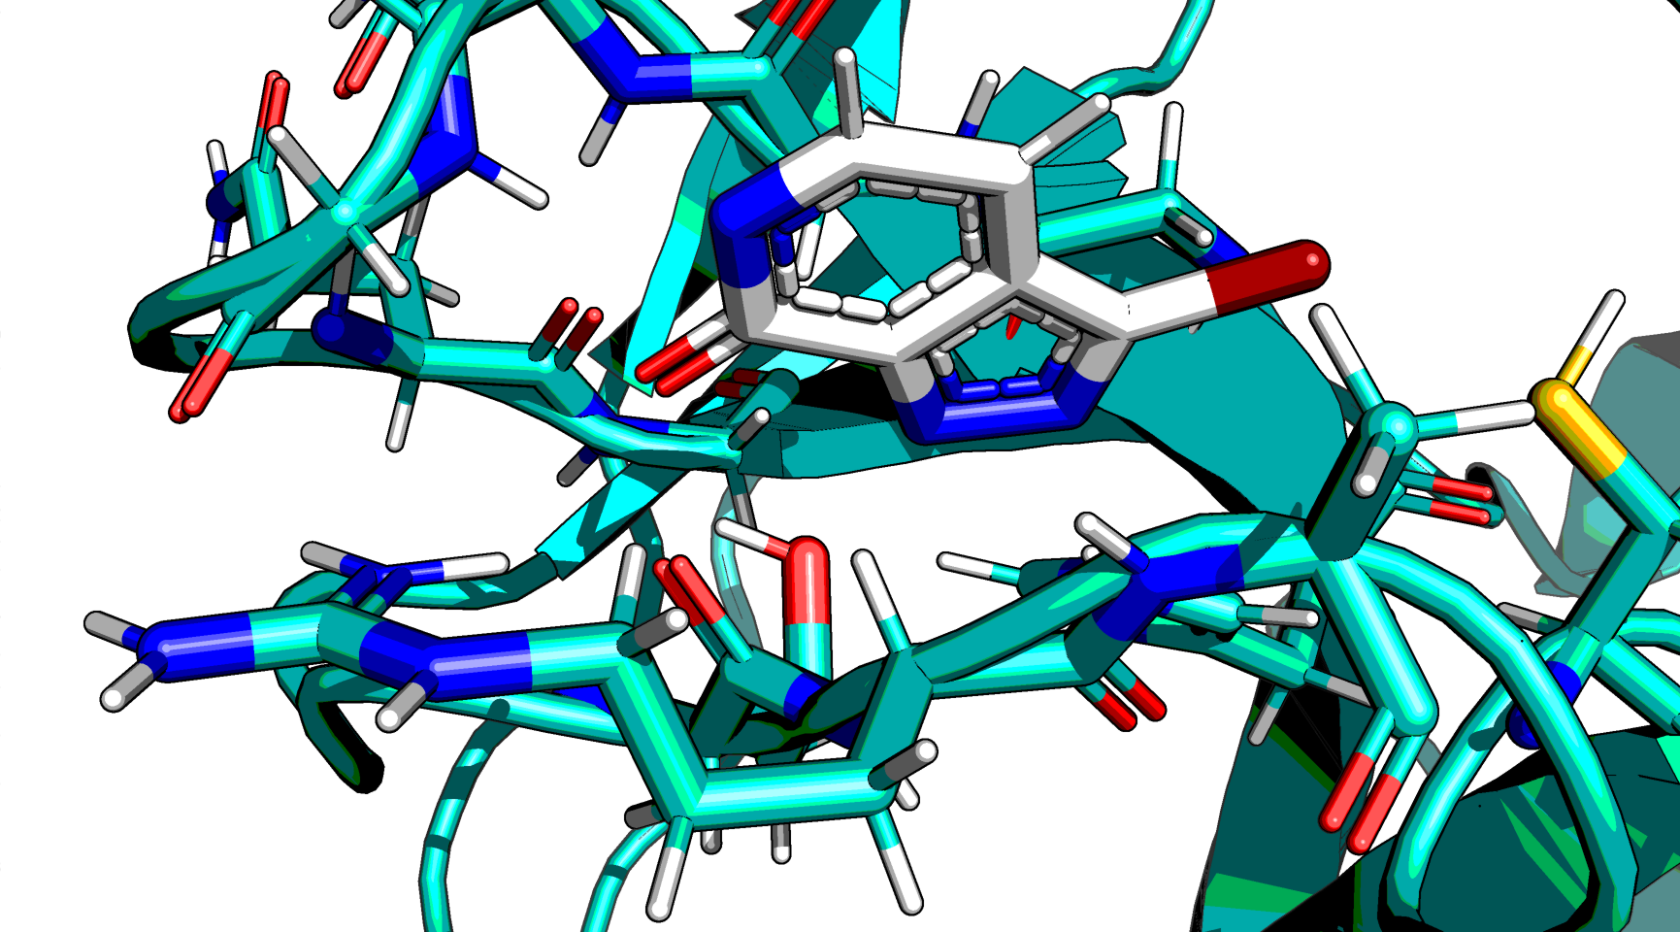
Trapped water. ZINC91252472?

Slide 18
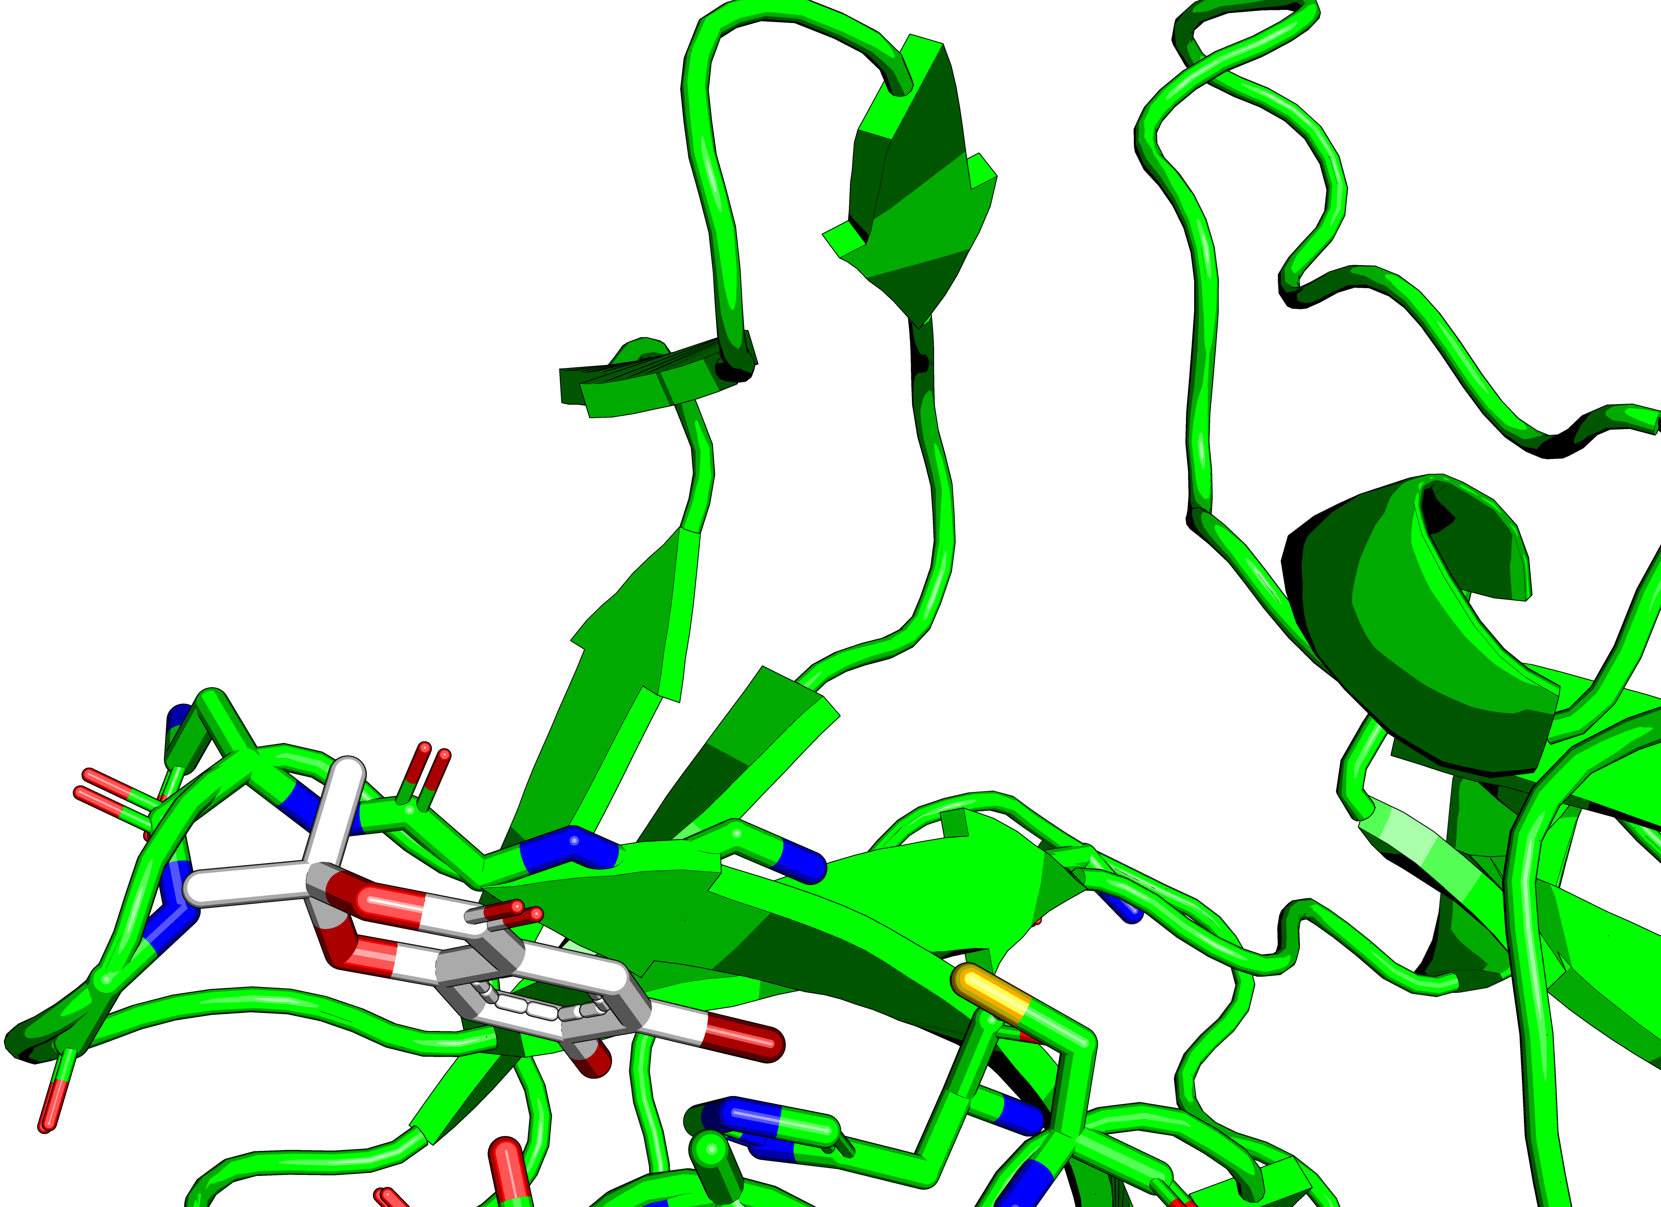
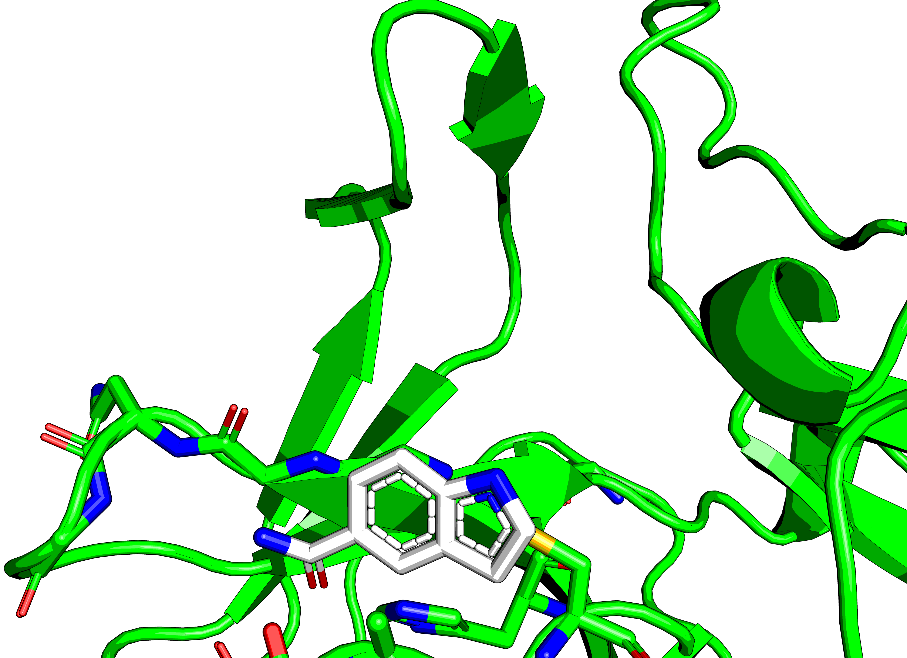
Thiol & soft orbitals
X1604
Br – S interaction
X0771
Pi – S interaction

Slide 19
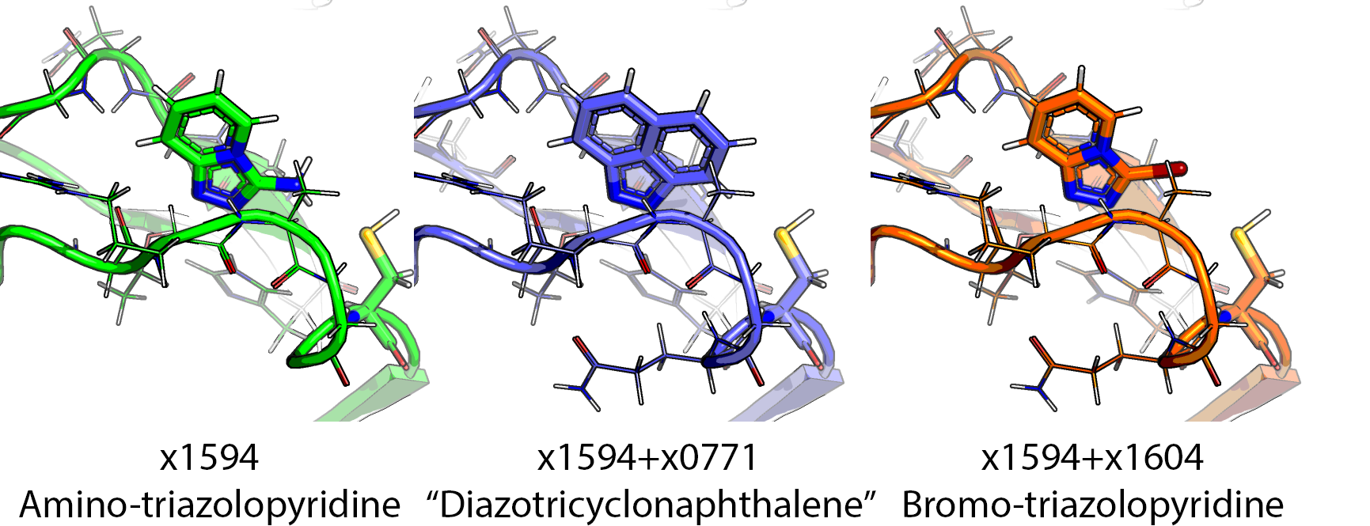
Semimanual mergers
This is predict to bind, but why is no rotated conf of x1594 seen then?

Slide 20
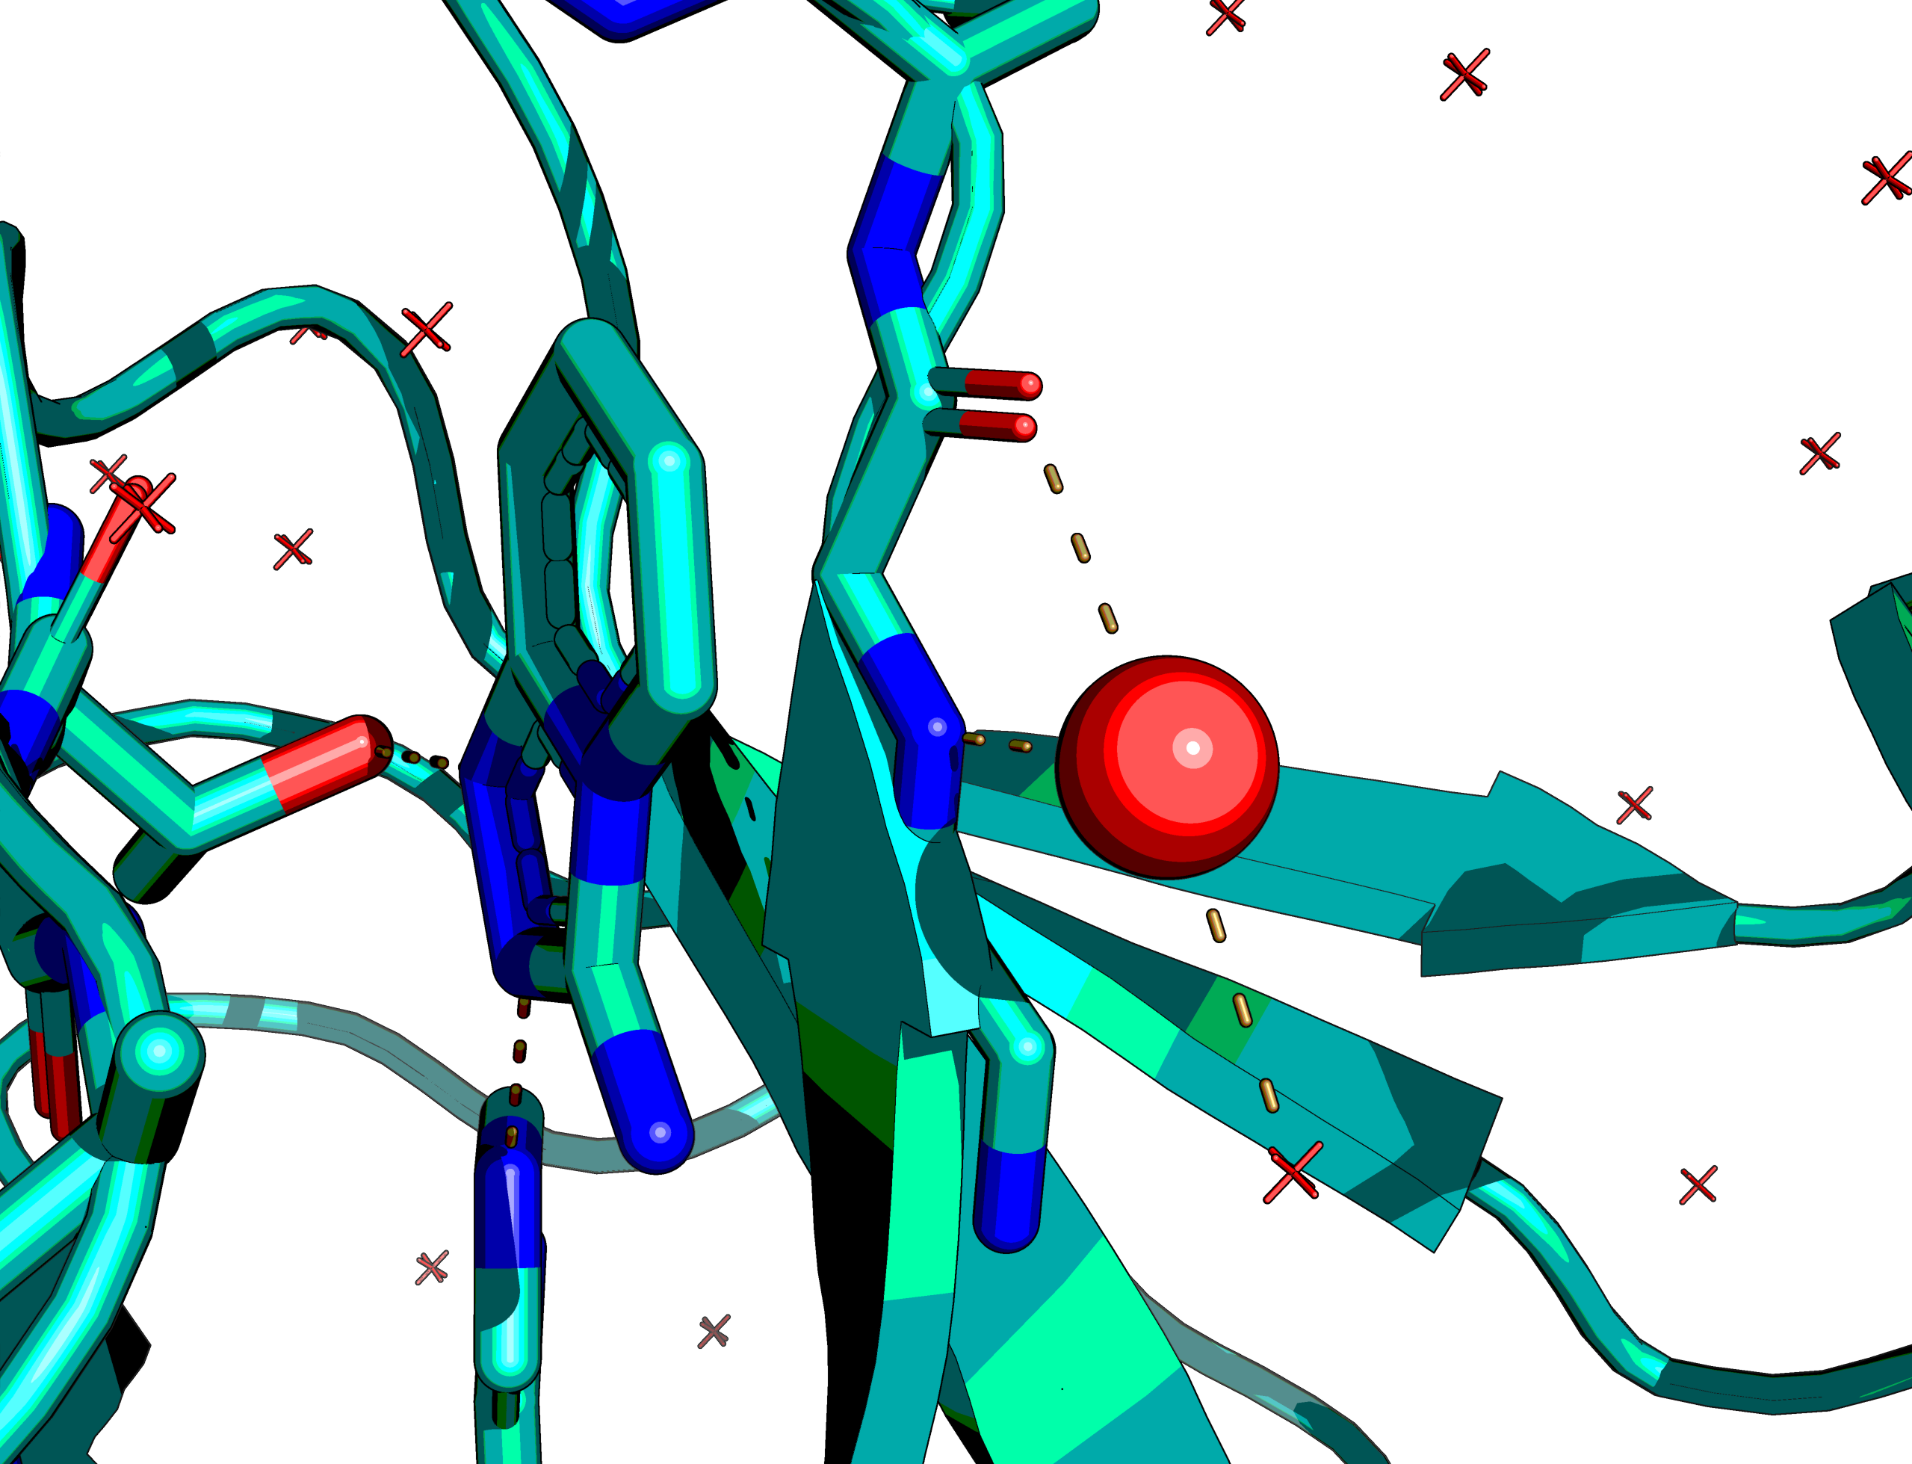
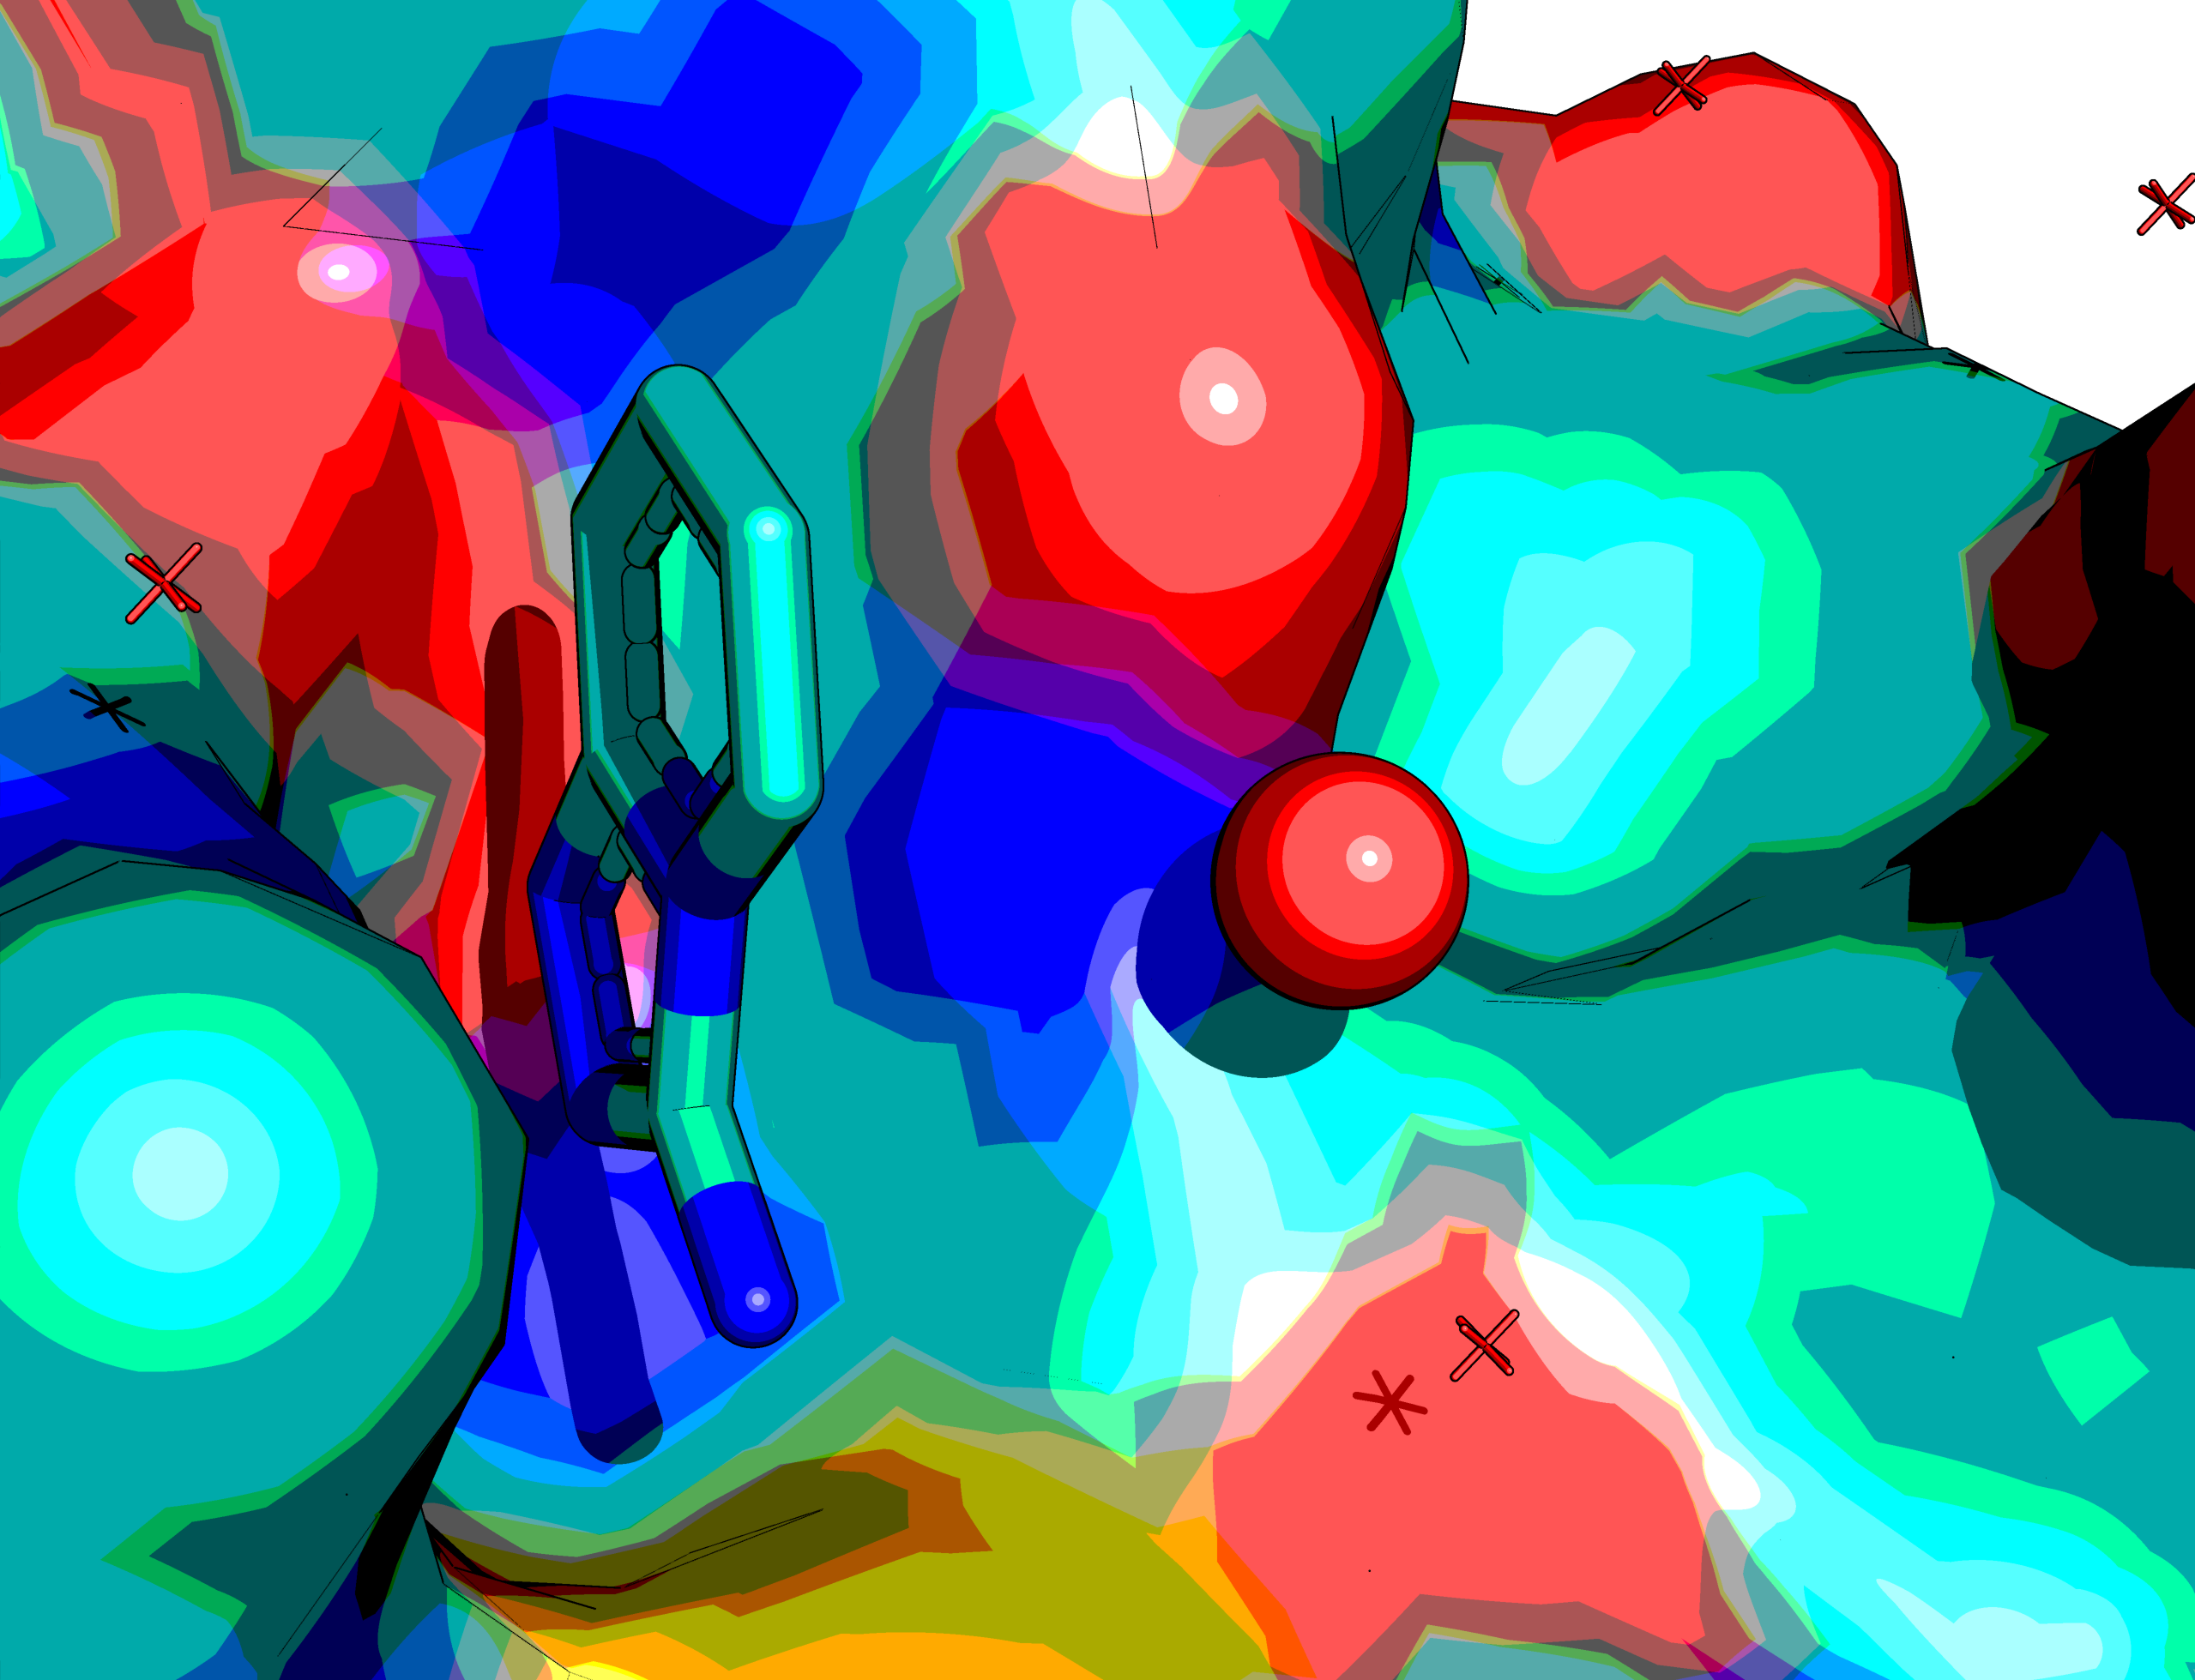
Water in the middle of P1 & P2
Pharmacophorically there is a water between the two. In 2B0F it is where peptidic amide of P2-P3 binds.
Why no lactam worked? There are 54 in the libraries tested…

Slide 21
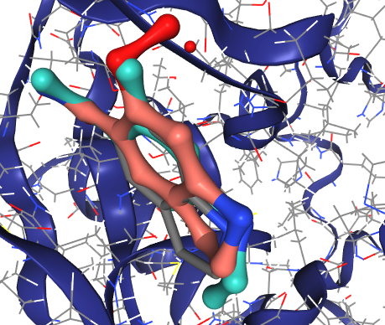
Mergers with “stepping stone water”
Water 64 is where the amide O of the peptide is, H-bonding w/ Backbone N of G163.
No mergers work.
PV-002498431347 is meta-hydroxymethyl-amido-benzene

Slide 22
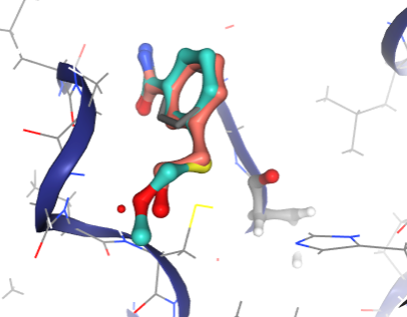
Mergers with “Oxyanion water”
https://michelanglo.sgc.ox.ac.uk/data/2019dcf0-672e-477c-97bd-cdb358ea91f8
4x waters + 1x bridged used as pharmacophores in ROCS against 0&1rota of Enamine BB and filtered by clashes: failed
Fragmenstein mergers don’t really reach either (Z2169269480 turquoise, x0771-elaboration)

Slide 23
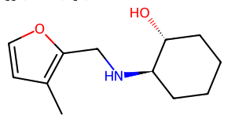
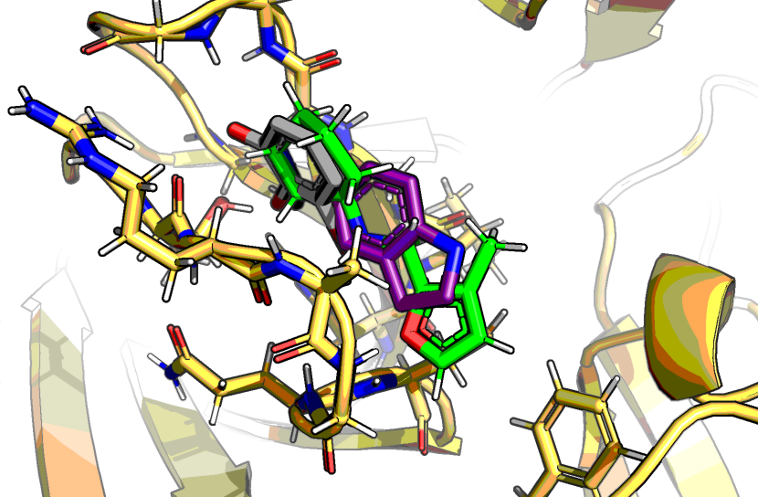
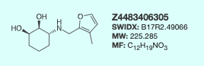
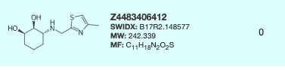
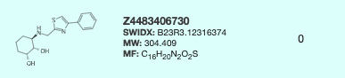
Parenthesis: Hantzsch thiazole
Z2568145378
Potential follow-ups to try:

Slide 24
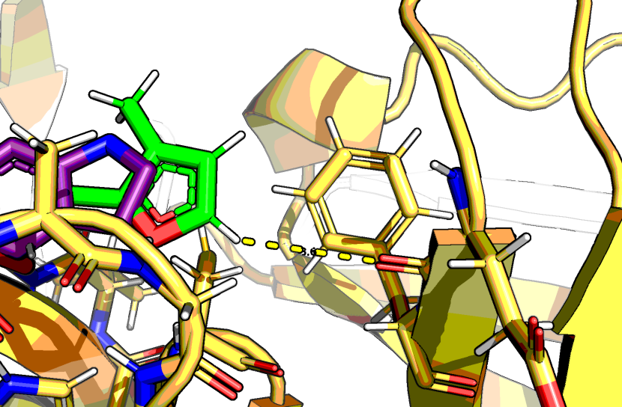
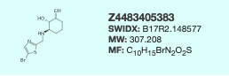
Parenthesis: Glu24 backbone would be ~3.6Å
But angle would be wrong
Not tested:

Slide 25
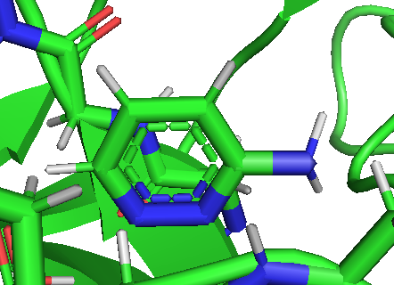
Has to be 5-ring
6-ring does not work

Slide 26
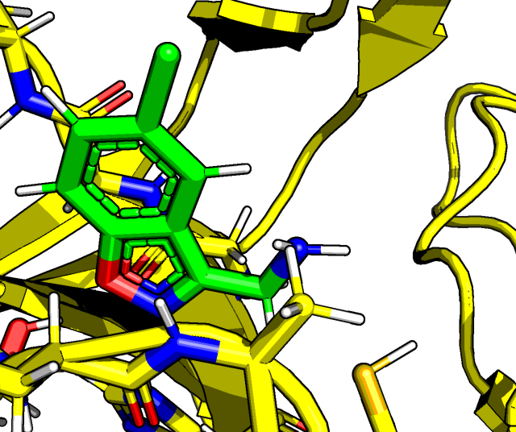
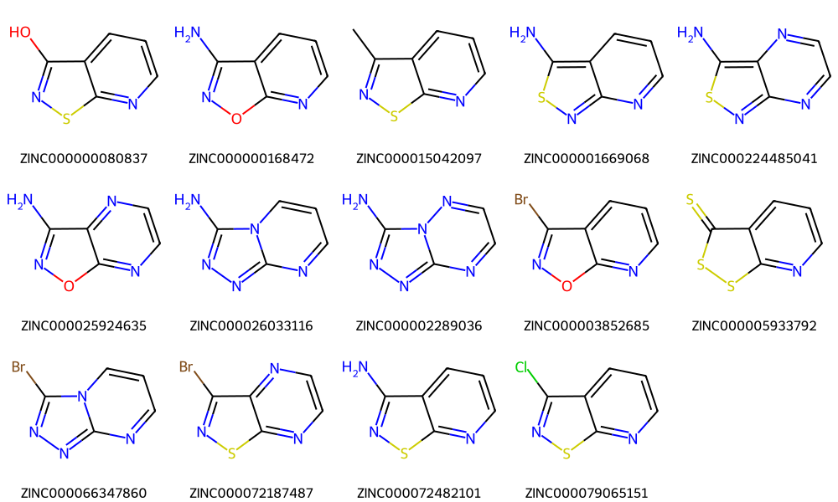
But not diazo
Enamine BB w/ 1 substituent & twin acceptors
ZINC20221762

Slide 27
ROCS

Slide 28
Drempt experiments

Slide 29
ANN generative fragment linking

Slide 30
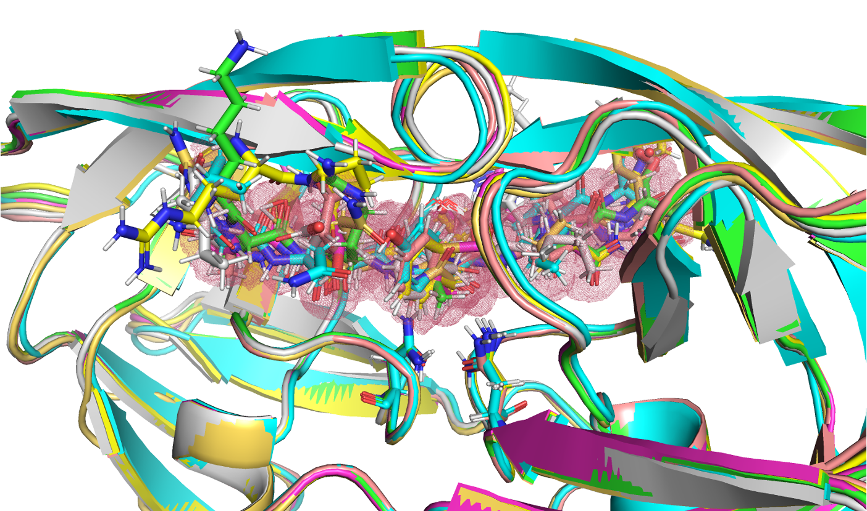
Substrate envelope
[Not performed]
Caelia Schiffer Lab (Shaqra et al. Nat Comms 2022)
Point cloud occupancy: One option for fragment filtering
Step 1. Conversion of peptidomimetic to native transition state — manual/PyRosetta
Step 2. Generation of other native substrates and transition state forms
Step 3. Rank hits by % within envelope

Slide 31
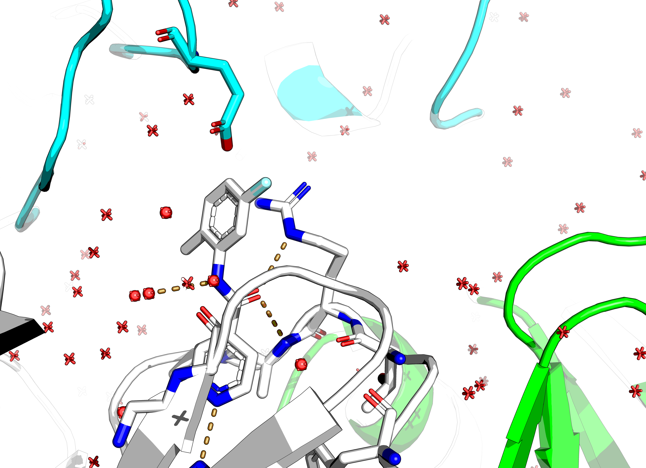
The Wobble
Variable R143 location: crystal packing or hit binding
[Not performed]
RMSD of bound structures
Utility?
Current: one template fits all

Slide 32
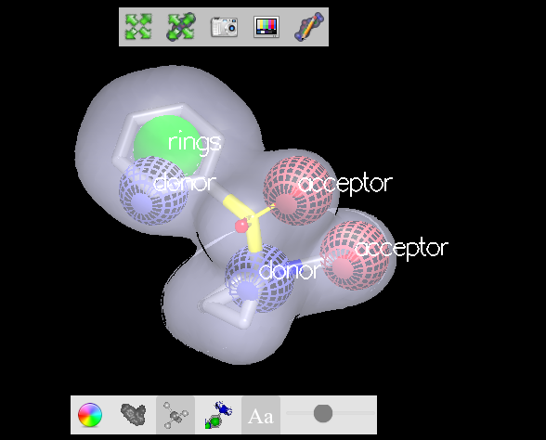
Water network
Crystallographic water are bound compounds albeit technically not organic and both donor & acceptors
Some –2 kcal/mol
Classification & pharmacophoric docking
[Not performed]
w/ OE ROCS (pictured)
w/ rDOCK

Slide 34
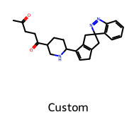
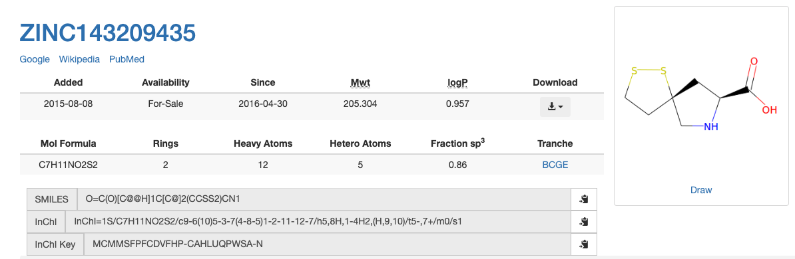
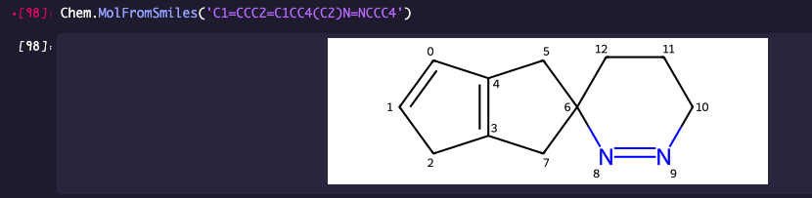
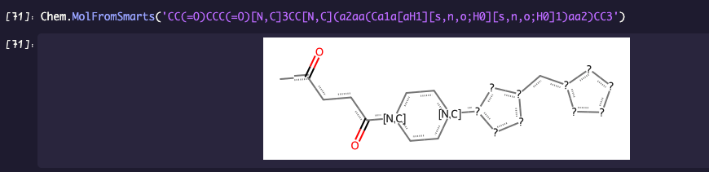
Warren’s Spiro
A spiro w/ a 2xacceptor is a problem, regardless of what element & ring size
The succinate-like + piperidine/piperazine/cyclohexane + r5-ring w/ ortho&meta-like subs is doable as trizole or thiazole in meta-like (=synthetic!) → not placed
Manual only. Not tried w/ SynSpace

Slide 35
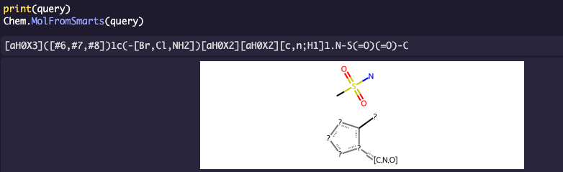
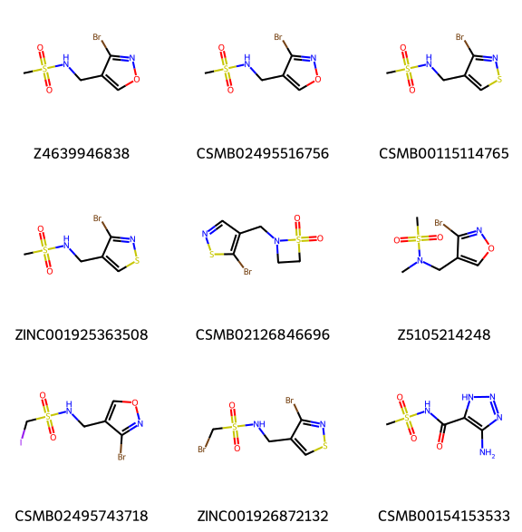
Arthorian quest
In arthor one can query SMARTS that are disconnected
It does not seem to like R & r notations, but can do rest
[aH0X3]([#6,#7,#8])1c(-[Br,Cl,NH2])[aH0X2][aH0X2][c,n;H1]1.N-S(=O)(=O)-C
Sulfonamide + bromo/chloro/amino–di-acceptor-r5
8,500 hits across multiple libaries
Need to map SMARTS to relevant hits & place these
And repeat for ureido

Slide 36
OE

